Slide 1
Managing Knowledge in Digital Enterprise
Laudon & Laudon
PowerPoint by Daniel Obuobi

Slide 2
The Knowledge Management Landscape
The knowledge-based core competencies of firms—the two or three things that an organization does best—are key organizational assets.
Knowledge management systems have become one of the fastest-growing areas of corporate and government software investment.

Slide 3
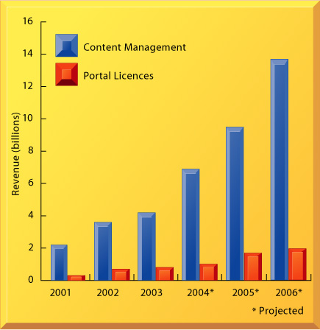
U.S. enterprise knowledge management software revenues, 2001–2006
FIGURE 12-1 U.S. enterprise knowledge management software revenues, 2001–2006
Enterprise knowledge management software includes sales of content management and portal licenses, which have been growing at a rate of 35 percent annually, making it among the fastest-growing software applications.
Source: Based on data in eMarketer, “Portals and Content Management Solutions,” June 2003.

Slide 4
Data, information , knowledge and wisdom – an important distinction
There is an important distinction between data, information, knowledge, and wisdom.
Data is defines as a flow of events or transactions captured by an organization’s systems that, by itself, is useful for transacting but little else.
To turn data into useful information, a firm must expend resources to organize data into categories of understanding, such as monthly, daily, regional, or store-based reports of total sales.
To transform information into knowledge, a firm must expend additional resources to discover patterns, rules, and contexts where the knowledge works.
Finally, wisdom is thought to be the collective and individual experience of applying knowledge to the solution of problems.
Wisdom involves where, when, and how to apply knowledge.

Slide 5
Knowledge Management
Knowledge management is a set of processes to create, store, transfer, and apply knowledge in the organization.
Knowledge management increases the ability of the organization to learn from its environment and to incorporate knowledge into its business processes.
The knowledge management value chain is a series of steps that add value to raw data and information as it is transformed into usable knowledge.
These steps include acquisition, storage, dissemination, and application of knowledge.

Slide 6
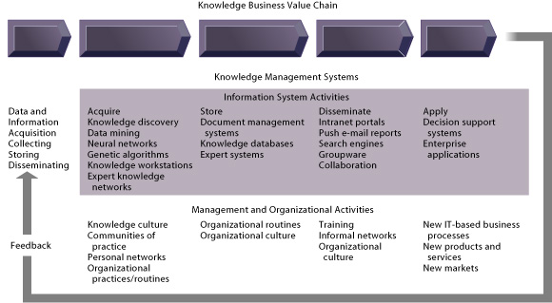
knowledge management value chain
FIGURE 12-2 The knowledge management value chain
Knowledge management today involves both information systems activities and a host of enabling management and organizational activities.

Slide 7
Important dimensions of knowledge
Companies use information systems to promote organizational learning by codifying their best practices and make both explicit knowledge and tacit knowledge of these practices more widely available to employees.
Knowledge storage generally involves the creation of a database.
  Document management systems that digitize, index, and tag documents according to a coherent framework are large databases adept at storing collections of documents.
Effective knowledge management systems require organizational and management capital to promote a “knowledge culture” and programs for knowledge management, including the creation of a chief knowledge officer (CKO) and communities of practice (COPs).
There are three major types of knowledge management systems:
  enterprise-wide knowledge management systems,
  knowledge work systems, and
  intelligent techniques.

Slide 8
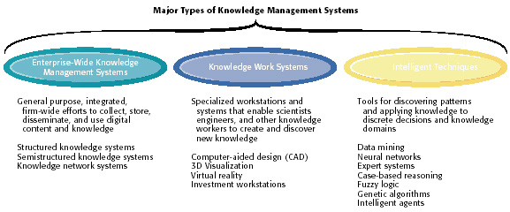
FIGURE 12-3 Major types of knowledge management systems
There are three major categories of knowledge management systems, and each can be broken down further into more specialized types of knowledge management systems.

Slide 9
Enterprise-Wide Knowledge Management Systems
Enterprise-wide knowledge management systems are firmwide efforts to collect, store, distribute, and apply digital content and knowledge.
They use an array of technologies for storing structured and unstructured content, locating employee expertise, searching for information, disseminating knowledge, and using data from key corporate systems.
Enterprise-wide knowledge management systems consist of structured knowledge systems, semistructured knowledge systems, and knowledge networks.

Slide 10
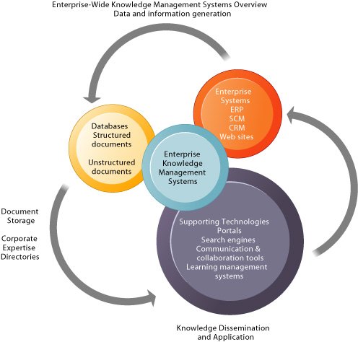
FIGURE 12-4 Enterprise-wide knowledge management systems
Enterprise-wide knowledge management systems use an array of technologies for storing structured and unstructured documents, locating employee expertise, searching for information, disseminating knowledge, and using data from enterprise applications and other key corporate systems.

Slide 11
Structured knowledge systems
Structured knowledge systems provide databases and tools for organizing and storing structured knowledge that exists in formal documents. KPMG International’s KWorld is an example.
It provides online access to presentations, white papers, best practice guidelines, methodologies, human resources information, professional resumes, research reports, and external news sources.
It also features a tool that permits collaboration among team members and clients in a secure Web environment

Slide 12
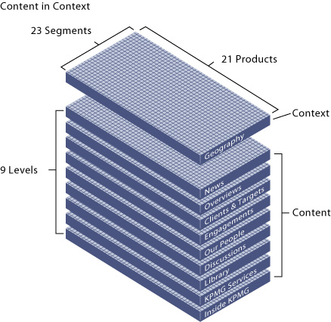
KWorld’s knowledge domains
FIGURE 12-5 KWorld’s knowledge domains
KPMG’s KWorld is organized into nine levels of content that are further classified by product, market segment, and geographic area.

Slide 13
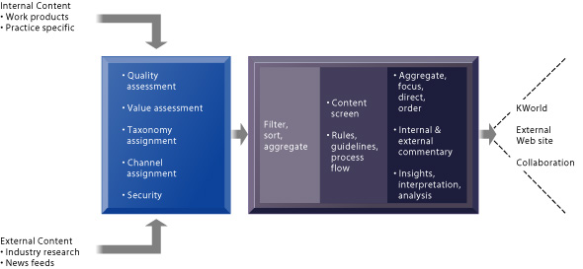
FIGURE 12-6 KPMG knowledge system processes
KPMG systems classify, filter, and organize content from both internal and external sources for use internally in KWorld and externally on the company Web site.

Slide 14
Semistructured knowledge systems
Semistructured knowledge systems provide databases and tools for organizing and storing semistructured knowledge, such as e-mail, brochures, or rich media, that is not in a formal document or report.
Such systems provide a database and technical infrastructure tracks, stores and organizes semistructured content.

Slide 15
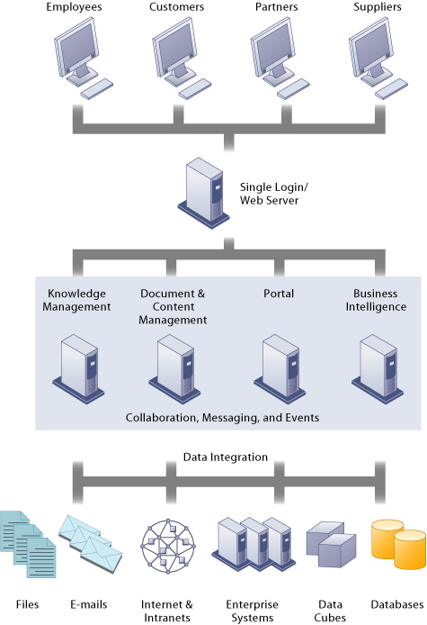
FIGURE 12-7 Hummingbird’s integrated knowledge management system

Slide 16
Hummingbird’s integrated Knowledge management system
Hummingbird’s enterprise solution combines document management, knowledge management, business intelligence, and portal technologies and can be used for managing semistructured as well as structured knowledge.

Slide 17
knowledge repositories
Structured and semistructured knowledge systems provide knowledge repositories.
Taxonomies and tagging are used to classify repository content so that it is easier to access.
To disseminate tacit knowledge, knowledge systems may provide directories and tools for locating firm employees with special expertise.
Knowledge network systems try to turn tacit, unstructured knowledge into explicit knowledge that can be shared in a database.

Slide 18
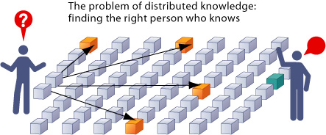
FIGURE 12-8 The problem of distributed knowledge
In many organizations, essential knowledge is not available even though someone in the firm may have the information. The problem is finding the right person or group.

Slide 19
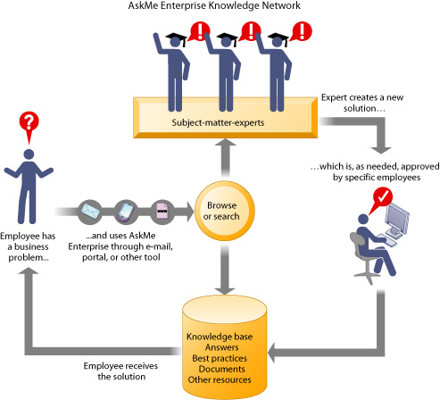
FIGURE 12-9 AskMe Enterprise knowledge network system
A knowledge network maintains a database of firm experts, as well as accepted solutions to known problems, and then facilitates the communication between employees looking for knowledge and experts who have that knowledge.
Solutions created in this communication are then added to a database of solutions in the form of FAQs, best practices, or other documents.

Slide 20
Collaborative tools in enterprise-wide knowledge management systems
Enterprise-wide knowledge management systems also include group collaboration tools (groupware and teamware), portals to simplify information access, search tools, and learning management systems.
Many organizations have built specialized enterprise portals to help individuals navigate through various knowledge resources.
These enterprise knowledge portals direct individuals to digital knowledge objects and information system applications, helping them make sense of the volume of information that is available and also showing how organizational knowledge resources are interconnected.

Slide 21
Knowledge Work Systems
Knowledge and data work are information work and both use many of the same information systems (particularly office systems).
However, knowledge work is also specialized and therefore needs additional specialized information systems.
Knowledge work is based on a codified body of knowledge, with practitioners requiring state or university certification and regulation by independent professional organizations.
Knowledge work systems (KWS) are information systems that aid knowledge workers in the creation and integration of new knowledge in the organization.
KWSs incorporate more links to external data and information than other rate systems.
KWS software contains far more powerful graphic, analytic, document management, and communications capabilities than other corporate systems, and KWSs also require considerably more computing power than other information work.
Because a knowledge worker's time is so costly, it is important that KWSs have a user-friendly interface so that the knowledge worker does not have to spend a great deal of time learning how to use the systems that provide needed information.

Slide 22
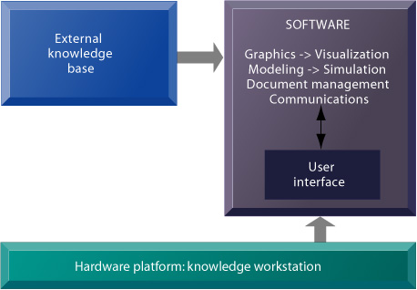
FIGURE 12-10 Requirements of knowledge work systems
Knowledge work systems require strong links to external knowledge bases in addition to specialized hardware and software.

Slide 23
KWS hardware
KWSs usually require the use of workstations that are often designed and optimized for specific tasks.
KWSs vary greatly, depending on the profession and specific application being supported. For example, design engineers need graphics with enough power to handle three-dimensional computer-aided design (CAD) systems.
Financial analysts need access to a myriad of external databases and optical disk technology so they can access massive amounts of financial data quickly.
Three different types of KWSs are: conventional (CAD) systems, virtual reality systems for simulation and modeling, and financial workstations.
CAD systems are information systems that automate the creation and revision of designs using sophisticated graphics software.
Design time and expensive engineering changes are significantly reduced because the design is done right before physical production begins.

Slide 24
Virtual reality systems
Virtual reality systems have visualization, rendering, and simulation capabilities that go far beyond those of conventional CAD systems.
Using interactive graphics software, virtual reality systems create computer-generated simulations that are so close to reality that users believe they are participating in a real world situation.
Depending on the application, the user may wear special clothing, headgear, and equipment to enter the world of virtual reality.
The clothing contains sensors that record the user's movements and immediately transmit that information back to the computer.
Using virtual reality systems, architects design a home and allow the users to walk through and experience the feel of each room.
The design can be modified or completely changed before a spade of dirt is turned.
Knowledge work systems for financial professionals provide access to external databases and the ability to access massive amounts of financial data quickly.
Specialized investment workstations provide a more open, flexible system environment that can be tailored to an individual's needs while also being able to integrate new software when needed.

Slide 25
Intelligent Techniques
Artificial intelligence and database technology provide a number of intelligent techniques that organizations use to capture individual and collective knowledge and to extend their knowledge base.
Artificial intelligence (AI) is the effort to develop computer-based systems (both hardware and software) that behave as humans, with the ability to learn languages, accomplish physical tasks, use a perceptual apparatus, and emulate human expertise and decision making.
Expert systems, case-based reasoning, and fuzzy logic are used for capturing tacit knowledge. An expert system is a knowledge-intensive computer program that captures the human expertise in limited domains of knowledge.
Expert systems lack the generality and breadth of knowledge of humans because they only capture human expertise in very limited areas. Nevertheless, these systems aid decision making by asking relevant questions and explaining the reasons for adopting certain actions.

Slide 26
How expert Systems work
Human knowledge must be modeled or represented in a way that a computer can process.
The model of human intelligence that is used in expert systems is called the knowledge base.
A series of rules (standard programming constructs such as IF-THEN) is one type of knowledge base.
AI programs have far more rules than traditional programs and the rules tend to be interconnected and nested to a far larger degree

Slide 27
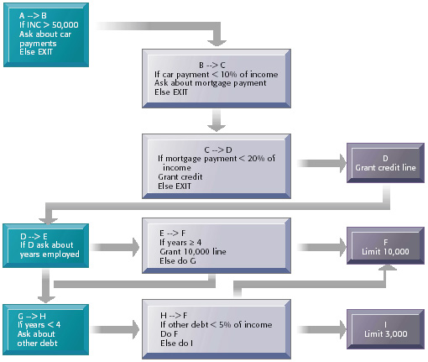
FIGURE 12-11 Rules in an AI program
An expert system contains a number of rules to be followed when used. The rules are interconnected; the number of outcomes is known in advance and is limited; there are multiple paths to the same outcome; and the system can consider multiple rules at a single time. The rules illustrated are for simple credit-granting expert systems.

Slide 28
How expert system work (2)
The AI development team is composed of several "experts" who have a thorough command over the knowledge engineers who translate the knowledge into a set of rules or frames.
A knowledge engineer is similar to a traditional system analyst, but has special expertise in eliciting information and expertise from other professionals.
The AI shell is the programming environment of an expert system.
Although AI systems can be developed in just about any programming language, AI shells are user-friendly environments that can quickly generate user interface screens, capture the knowledge base, and manage the strategies for searching the rule base.
The strategy to search through the rule base, called the inference engine, can be either forward or backward chaining.
In forward chaining, the inference engine begins with the information entered by the user and searches the rule base to arrive at a conclusion.
In backward chaining, an expert systems acts more like a problem solver. The strategy for searching the rule base starts with a hypothesis and proceeds by asking the user questions about selected facts until the hypothesis is either confirmed or disproved.

Slide 29
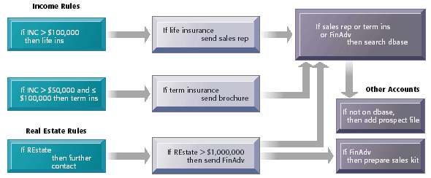
FIGURE 12-12 Inference engines in expert systems
An inference engine works by searching through the rules and “firing” those rules that are triggered by facts gathered and entered by the user. Basically, a collection of rules is similar to a series of nested IF statements in a traditional software program; however, the magnitude of the statements and degree of nesting are much greater in an expert system.

Slide 30
Step in building Expert systems
Typically, building an expert system involves several steps.
Team members must identify a problem appropriate for an expert system and develop a prototype system to test ways of encoding the knowledge of experts.
Then a full-scale system will be developed focusing mainly on the addition of a very large number of rules.
When the experts and knowledge engineers are satisfied that the system is complete, it can be tested by a range of experts within the organization against performance criteria established in earlier stages.
Once tested, the system will be integrated into the organization, and finally, the system must be maintained.
Expert systems are most successful at automating lower-level clerical functions.
Even in these comparatively simple situations, however, expert systems require large, lengthy, and expensive development efforts.

Slide 31
Organizational intelligence: case-based Reasoning
Expert systems are an intelligent technique for capturing tacit knowledge in a very specific and limited domain of human expertise.
These systems capture the knowledge of skilled employees in the form of a set of rules in a software system that can be used by others in the organization.
The set of rules in the expert system adds to the memory, or stored learning, of the firm.
Expert systems lack the breadth of knowledge and the understanding of fundamental principles of a human expert.
They typically perform very limited tasks that can be performed by professionals in a few minutes or hours, such as diagnosing a malfunctioning machine or determining whether to grant credit for a loan.
Problems that cannot be solved by human experts in the same short period of time are far too difficult for an expert system.
However, by capturing human expertise in limited areas, expert systems can provide benefits, helping organizations make high-quality decisions with fewer people.
Today expert systems are widely used in business in discrete, highly structured decision-making situations.

Slide 32
Case-base reasoning
Case-base reasoning involves storing past experiences of human experts represented by cases on a database.
When a user encounters a new case, the system searches for similar parameters within the cases, finds the closest fit, and applies the solutions of the old case to the new case.
Successful solutions are tagged to the new case and stored together in the knowledge base.
Unsuccessful solutions are also appended to the new case along with an explanation of why the solutions didn't work.
In contrast to rule-based expert systems, the knowledge base for the case-based reasoning system is continuously expanded and refined by users.

Slide 33
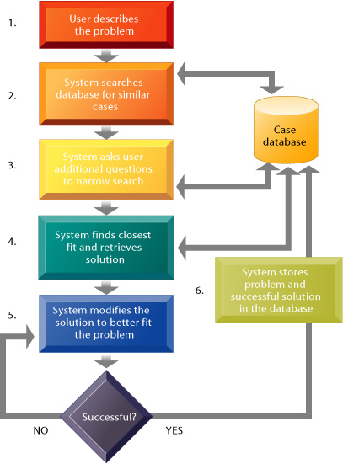
FIGURE 12-13 How case-based reasoning works
Case-based reasoning represents knowledge as a database of past cases and their solutions. The system uses a six-step process to generate solutions to new problems encountered by the user.

Slide 34
Fuzzy logic
Fuzzy logic is software that expresses logic with some carefully defined imprecision so that it is closer to the way people actually think than traditional IF-THEN rules.
Fuzzy logic is being used to control physical devices such as auto-focusing cameras and thermostat controls and is starting to be used for limited decision-making applications.

Slide 35
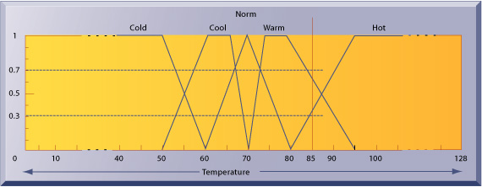
FIGURE 12-14 Implementing fuzzy logic rules in hardware
The membership functions for the input called temperature are in the logic of the thermostat to control the room temperature. Membership functions help translate linguistic expressions such as warm into numbers that the computer can manipulate.
Source: James M. Sibigtroth, “Implementing Fuzzy Expert Rules in Hardware,” AI Expert, April 1992. © 1992 Miller Freeman, Inc. Reprinted with permission.

Slide 36
Neural networks
Neural networks and datamining are used for knowledge discovery.
Neural networks consist of hardware or software that attempts to emulate the processing patterns of the biological brain.
In neural networks, the physical machine emulates a human brain that can be "taught" from experience.
Neural networks are constructed by using specialized hardware computers or by using neural network software on a traditional computer.
The network is trained by controlling the flow of messages to adjust the resistors in the circuits.
Eventually the network will be able to find a pattern of connections that allows it to carry out a desired computation.
Because of their ability to "learn" without programming and to recognize patterns, neural networks are successfully being used in science, medicine, and business primarily to discriminate patterns in massive amounts of data.

Slide 37
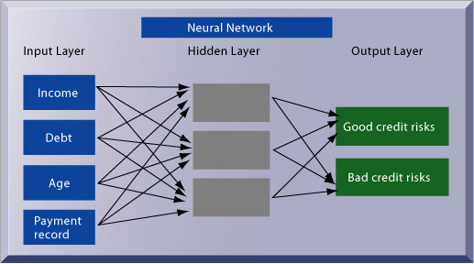
FIGURE 12-15 How a neural network works
A neural network uses rules it “learns” from patterns in data to construct a hidden layer of logic. The hidden layer then processes inputs, classifying them based on the experience of the model.
Source: Herb Edelstein, “Technology How-To: Mining Data Warehouses,” InformationWeek, January 8, 1996. Copyright © 1996 CMP Media, Inc., 600 Community Drive, Manhasset, NY 12030. Reprinted with permission.

Slide 38
Genetic algorithms
Genetic algorithms are used for generating solutions to problems that are too large and complex for human beings to analyze on their own. They are based on problem solving methods that promote the evolution of solutions using methods employed by living organisms to adapt to their environment.
Processes such as fitness, crossover, and mutation are used to "breed" solutions. Genetic algorithms are starting to be used for problems involving optimization, product design, and monitoring industrial systems.

Slide 39
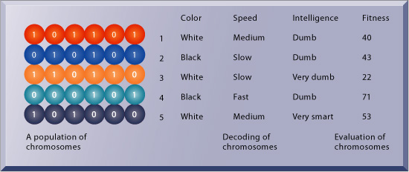
FIGURE 12-16 The components of a genetic algorithm
This example illustrates an initial population of “chromosomes,” each representing a different solution. The genetic algorithm uses an iterative process to refine the initial solutions so that the better ones, those with the higher fitness, are more likely to emerge as the best solution.
Source: From Intelligent Decision Support Methods by Vasant Dhar and Roger Stein, p. 65, © 1997. Reprinted by permission of Prentice Hall, Upper Saddle River, New Jersey.

Slide 40
Hybrid AI systems
Hybrid AI systems, which integrate genetic algorithms, fuzzy logic, neural networks, and expert systems, are being developed to take advantage of the best features of each technology.
Intelligent agents automate routine tasks to help firms search for, filter, and act on information in electronic commerce, supply chain management, and other activities.
Intelligent agents are software programs with a built-in or learned knowledge base that can carry out specific, repetitive, and predictable tasks for an individual user, business process, or software application.
Intelligent agents are programmed to make decisions based on the user’s personal preferences, making them useful for filtering e-mail, scheduling appointments, or searching for the best price of airline tickets over the Internet.

Slide 41
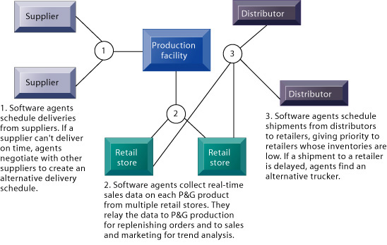
FIGURE 12-17 Intelligent agents in P&G’s supply chain network
Intelligent agents are helping Procter & Gamble shorten the replenishment cycles for products such as a box of Tide.

Slide 42
Management Issues for Knowledge Management Systems
Businesses armed with proprietary knowledge about their customers and operations have what could be called an “invisible competitive advantage” if this knowledge is not available to competitors and cannot be purchased by others in the marketplace.
However, knowledge management systems are difficult to implement successfully and they do not always provide value after they are put in place.
Common difficulties include insufficient resources for structure and updating repositories, insufficient validating systems resulting in poor content quality; a lack of context given to documents in repositoires, making them difficult to understand; resistance by workers in sharing knowledge; and inappopriate search engines.
Firms provide appropriate organizational and management capital to make these systems successful by rewarding knowledge sharing, promoting communities of practice and a “knowledge culture,” and designing appropriate taxonomies for organizing knowledge.
Proper planning, development of appropriate measurements of benefits, and staged rollout increase the chances of success for knowledge management projects.

Slide 43
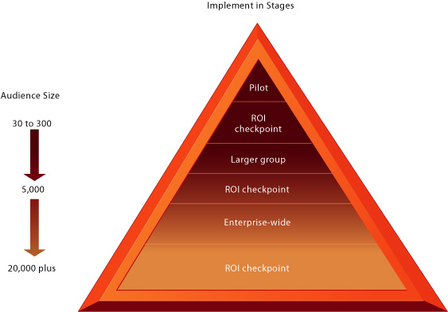
FIGURE 12-18 Implementing knowledge management projects in stages
Knowledge management projects have a greater chance of succeeding if they are implemented in stages with clearly defined ways of measuring results.

Slide 44
End

